Slide 1
Computer Architecture I
Group 4D
An Hu
Donai Long
Bo Peng
Jackie Preston

Slide 2
Unique Aspects of the Design
Initially a one-register accumulator
Became an accumulator with stack-like implementation

Slide 3
Unique Aspects of the Design
Processor uses very few registers:
Chose hexadecimal for machine language

Slide 4
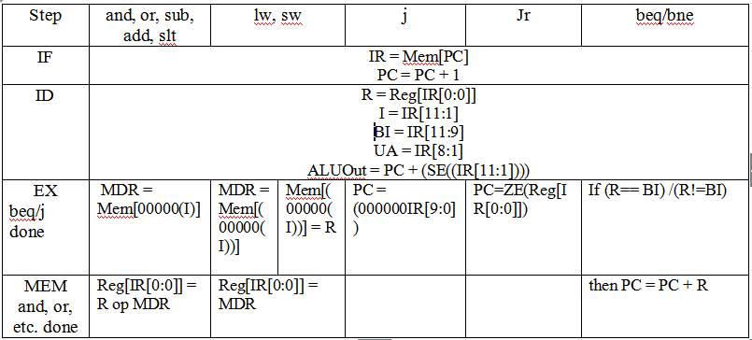
Unique Aspects (RTL)

Slide 5
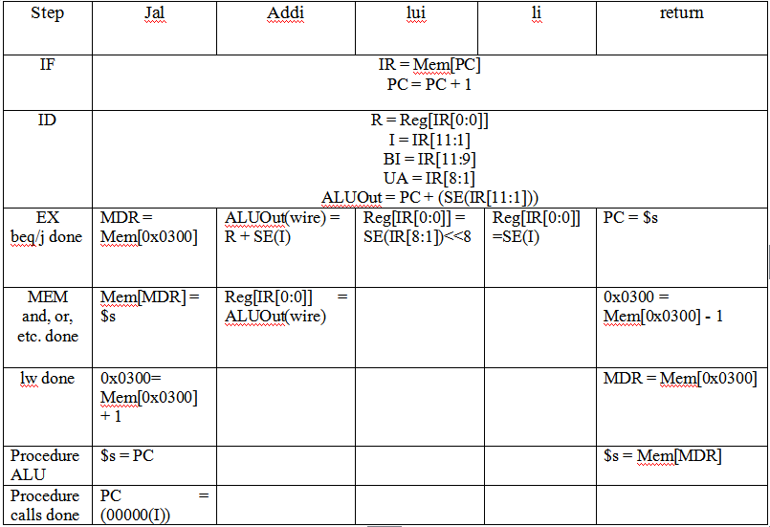
Unique Aspects (RTL)

Slide 6
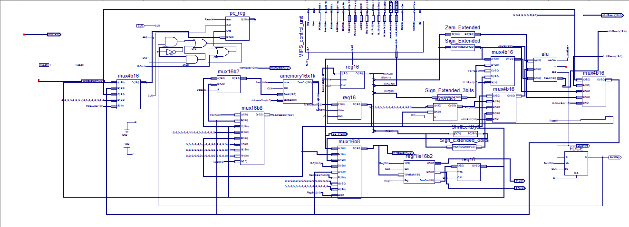
DataPath

Slide 7
Changes We’d Like to Make
Add more registers
Add interrupts
Make it a pipeline

Slide 8
Challenging Aspects
How to properly implement instructions
Creating our block memory
  Not technically challenging just very annoying
Integration Testing
Clock
  Admit you all had this same problem

Slide 9
Interesting Aspects
Operations
  What makes our processor special… in a good way
  Collaborative effort

Slide 10
The (not so) Wonderful World of Xilinx
IOB Devices
Error and warning messages

Slide 11
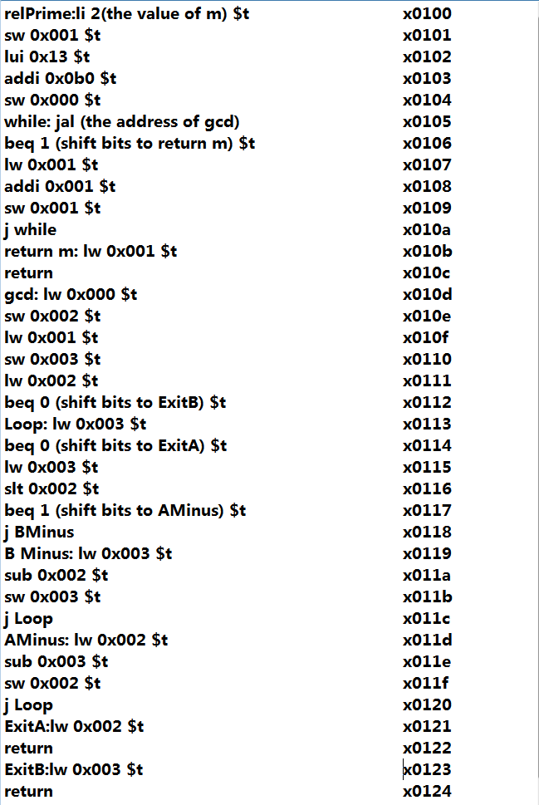
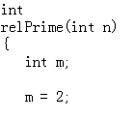
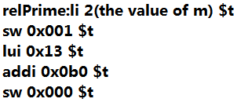
Euclid's Algorithm & relPrime

Slide 12
Euclid's Algorithm & relPrime
112261 Instructions execute in relPrime
367506 cycles involve in relPrime
3.273 cycles/instruction in average
88 Bytes needed to implement the design
  74 Bytes = 37 Instructions * 2Bytes/Instruction
  8 Bytes = 4 Variables *2Bytes/Variable
  4 Bytes = 2 Return Address *2Bytes/Return
  2 Bytes = Stack Pointer

Slide 13
Euclid's Algorithm & relPrime
77.472ns
for one single cycle in average
138.988ms
for the whole relPrime to finish
13.518MHz
is the Maximum Frequency

Slide 14
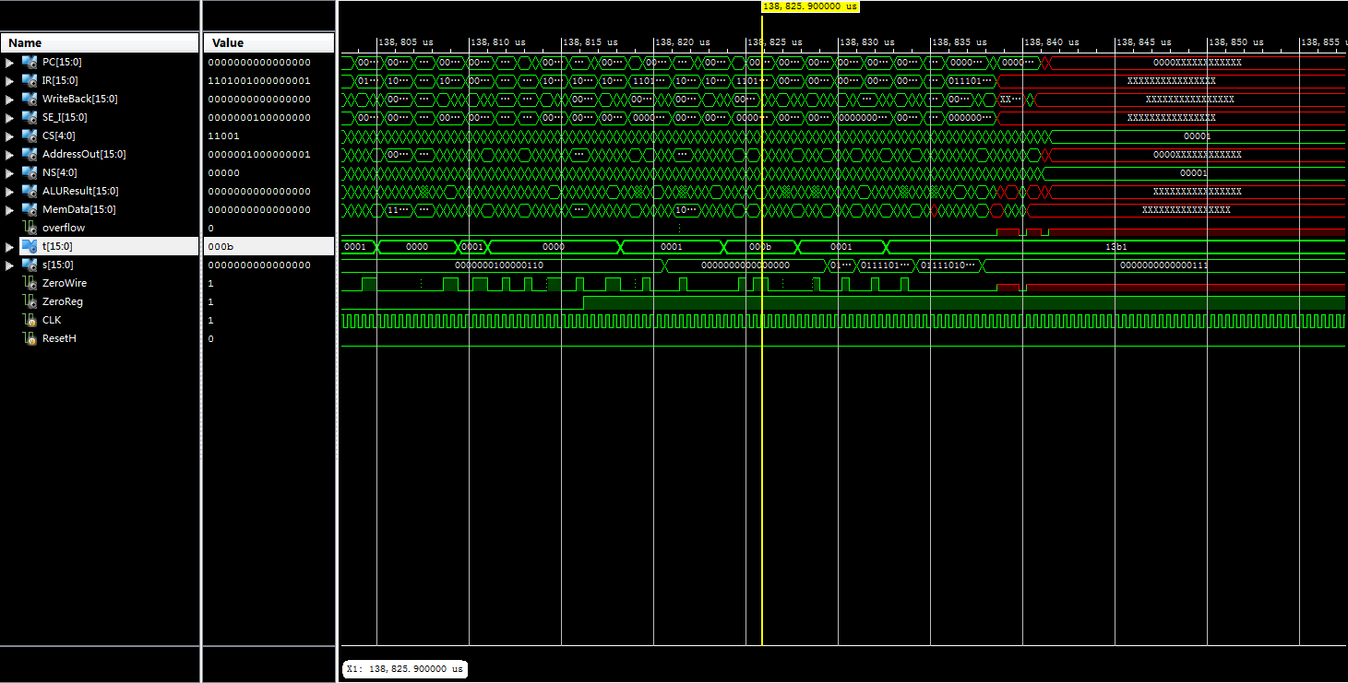

Slide 15
Euclid's Algorithm & relPrime
IOB Devices
Error and warning messages

